Slide 1

Quality of Attention Index

Slide 2



About the project
Methodology
Media List included in the study
Printed magazines
Magazine websites or apps
Printed newspapers
Newspaper websites or apps
Live or scheduled TV
Streaming/on-demand TV (e.g. Netflix, TVNZ+)
Online video (e.g. YouTube, TikTok video, Reels)
Social media (e.g. Facebook, Instagram, TikTok, LinkedIn)
Commercial radio
Podcasts
Outdoor advertising (e.g. billboards, bus shelters)
Retail media (e.g. retailer websites, apps, email)
Nationally representative sample
(by gender, age and location) of New Zealanders aged 18+
Sample size of n=1,037
15-minute online survey
A nationally representative sample is important for the credibility of the research. It allows true cross-media comparison and reflects real-world media consumption.

Slide 3





Why did we build the QAI
Simple.
Modern advertising research increasingly tells us that effectiveness depends on more than impressions or reach.
Advertisers now care about:
Attention
Engagement
Trust
Context
Memory
The QAI was designed to bring these together into a practical measure of media quality.

Slide 4
About the Quality of Attention Index
The QAI comprises five elements, each of which includes four statements asked on a 5-point agreement scale:
Focused Attention
Low
Distraction
Active Engagement
Receptive Mindset
Memory / Residual Effect
Level of concentration
Absence of multi-tasking
Mental involvement
Trust, enjoyment, openness
Recall and impact
The ‘Quality of Attention Index’ (QAI) and Ad Attention Index are derived from an original survey-based framework informed by established industry research on attention, engagement, and media context. They combines multiple validated dimensions into a single, comparable measure of attention quality across selected media. It will enable comparisons to be made and provide actionable insights for the MPA and publishers to use.
The Ad Attention Index is drawn from the results of the following six statements:
I notice the advertising
Advertising catches my attention
Advertising feels relevant
Advertising fits naturally with the content
Advertising feels less intrusive than it does in other media
I am more likely to act on the advertising in this medium

Slide 5

User Definitions
We have used the following user definitions:
Active Users:
Have interacted or engaged with the medium in the last 7 days
Last Month Users
Interacted or engaged with the medium in the last month but not the last seven days
Casual and Non-Users
Have used but longer ago or not used

Slide 6
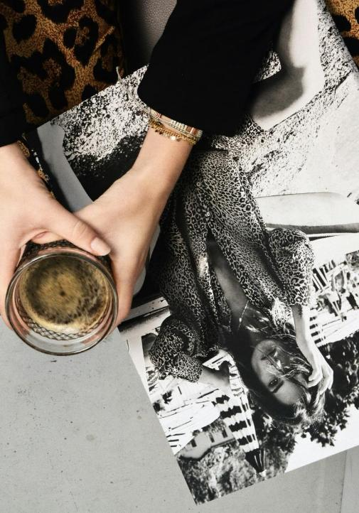
Engagement
Section 1

Slide 7
Engagement
 |  | NET ACTIVE USER | WITHIN LAST MONTH
Printed magazines |  | 21% | 20%
Magazine websites or apps |  | 24% | 16%
Printed newspapers |  | 29% | 15%
Newspaper websites or apps |  | 61% | 13%
Live or scheduled TV |  | 65% | 12%
Streaming/on-demand TV |  | 80% | 7%
Online video |  | 84% | 7%
Social media |  | 89% | 3%
Search engines |  | 95% | 3%
Commercial radio |  | 60% | 11%
Podcasts |  | 34% | 15%
Outdoor advertising |  | 49% | 18%
Retail media |  | 71% | 17%
Q4. When did you last use or engage with each of the following?
Base: Total Sample (1037)
Txt; Txt = Significantly higher / lower @95% confidence level

Slide 8












Engagement
Q5. Where were you
Home leading the way, small amount of engagement at work
Travelling and commuting for radio and outdoor
Printed Magazines
Magazine websites or apps
Printed newspapers
Newspaper websites or apps
Live or scheduled TV
Streaming/
on-demand TV
Online
video
Social
media
Search
engines
Commercial radio
Podcasts
Outdoor advertising
Retail media
At home
At work
Travelling/commuting
Public place
In a shop
Outdoors
Somewhere else
Base: n= | 438 | 421 | 362 | 359 | 358 | 350 | 355 | 481 | 597 | 349 | 353 | 353 | 355
Base: Total Sample (1037)
Txt; Txt = Significantly higher / lower @95% confidence level

Slide 9
Engagement
Q6. What were you mainly doing?
Magazines – print and digital - mainly for relaxing and passing time
Printed Magazines
Magazine websites or apps
Printed newspapers
Newspaper websites or apps
Live or scheduled TV
Streaming/
on-demand TV
Online
video
Social
media
Search
engines
Commercial radio
Podcasts
Outdoor advertising
Retail media
Relaxing
Looking for information
Being entertained
Keeping up to date
Passing time
Researching something to buy
Connecting with others
Background use
Other (please specify)
Base: n= | 438 | 421 | 362 | 359 | 358 | 350 | 355 | 481 | 597 | 349 | 353 | 353 | 355
Base: Total Sample (1037)
Txt; Txt = Significantly higher / lower @95% confidence level

Slide 10
Engagement
Q7. How long did you spend?
Almost half engaging with their printed magazine for 16 minutes plus
One in five engaging with magazine websites or apps for between 16 and 30 minutes
Printed Magazines
Magazine websites or apps
Printed newspapers
Newspaper websites or apps
Live or scheduled TV
Streaming/
on-demand TV
Online
video
Social
media
Search
engines
Commercial radio
Podcasts
Outdoor advertising
Retail media
Less than 1 minute
1–5 minutes
6–15 minutes
16–30 minutes
31–60 minutes
More than 60 minutes
Not sure
Base: n= | 438 | 421 | 362 | 359 | 358 | 350 | 355 | 481 | 597 | 349 | 353 | 353 | 355
Base: Total Sample (1037)
Txt; Txt = Significantly higher / lower @95% confidence level

Slide 11


Engagement
Printed Magazines
Q7. How long did you spend – Printed Magazines?
Active users tending to invest more time in their magazines
Base: Total Sample (1037)
Txt; Txt = Significantly higher / lower @95% confidence level

Slide 12


Engagement
Magazine
Websites
or Apps
Q7. How long did you spend – Magazine Websites or Apps?
Base: Total Sample (1037)
Txt; Txt = Significantly higher / lower @95% confidence level

Slide 13
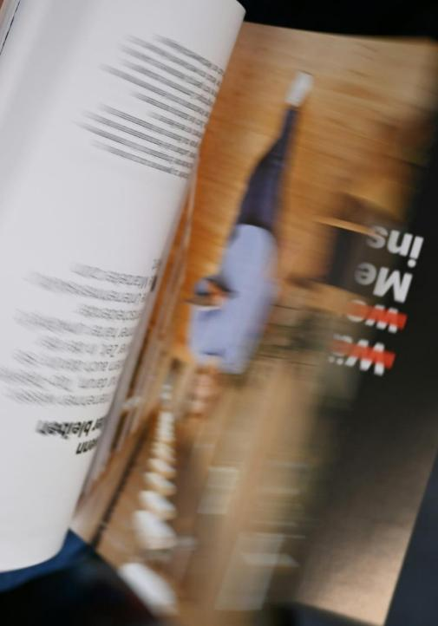
Quality of Attention Index
Section 2

Slide 14

The QAI comprises five elements, each of which includes four statements asked on a 5-point agreement scale:
Focused
Attention
Low
Distraction
Active
Engagement
Receptive
Mindset
Memory /
Residual Effect
Level of concentration
Absence of multi-tasking
Mental involvement
Trust, enjoyment, openness
Recall and impact

Slide 15











Quality of Attention Index Active Users
Printed Magazines
Podcasts
Streaming/
on-demand TV
Printed newspapers
Online
video
Retail
media
Live or scheduled
TV
Newspaper websites
or apps
Magazine websites
or apps
Social
media
Commercial radio
Outdoor advertising
73.7 | 73.4 | 72.9 | 70.3 | 70.3 | 69.7 | 68.2 | 68.1 | 67.4 | 66.6 | 58.8 | 45.8
Total Respondents

Slide 16
Quality of Attention Index Active Users by Gender
Printed Magazines
Podcasts
Streaming/
on-demand TV
Printed newspapers
Online
video
Retail
media
Live or scheduled
TV
Newspaper websites
or apps
Magazine websites
or apps
Social
media
Commercial radio
Outdoor advertising
73.7 | 73.4 | 72.9 | 70.3 | 70.3 | 69.7 | 68.2 | 68.1 | 67.4 | 66.6 | 58.8 | 45.8
72.6 | 72.0 | 71.8 | 70.6 | 69.6 | 70.2 | 68.1 | 68.8 | 67.9 | 65.8 | 59.3 | 49.7
74.7 | 75.0 | 73.9 | 70.0 | 71.2 | 69.2 | 68.3 | 67.5 | 66.7 | 67.3 | 58.3 | 42.7
Total | Male | Female

Slide 17
Quality of Attention Index Active Users by Age
Printed Magazines
Podcasts
Streaming/
on-demand TV
Printed newspapers
Online
video
Retail
media
Live or scheduled
TV
Newspaper websites
or apps
Magazine websites
or apps
Social
media
Commercial radio
Outdoor advertising
73.7 | 73.4 | 72.9 | 70.3 | 70.3 | 69.7 | 68.2 | 68.1 | 67.4 | 66.6 | 58.8 | 45.8
68.6 | 73.2 | 70.5 | 69.4 | 68.4 | 64.2 | 64.3 | 65.1 | 63.9 | 67.6 | 56.9 | 45.3
70.7 | 71.9 | 69.9 | 64.8 | 69.5 | 67.5 | 64.1 | 66.9 | 67.9 | 67.1 | 58.2 | 49.3
72.2 | 73.8 | 72.2 | 66.2 | 69.0 | 71.0 | 68.2 | 68.4 | 67.4 | 69.1 | 58.6 | 50.7
75.5 | 76.4 | 75.9 | 73 | 71.5 | 69.6 | 70.4 | 68.2 | 69.9 | 63.2 | 59.7 | 43.6
76.6 | 71.7 | 76.0 | 74.1 | 73.7 | 75.5 | 69.8 | 70.5 | 67.5 | 66.8 | 59.5 | 40.3
Total | 18-29 | 30-39 | 40-49 | 50-64 | 65 or above

Slide 18
Quality of Attention Index Active Users by Location
Printed Magazines
Podcasts
Streaming/
on-demand TV
Printed newspapers
Online
video
Retail
media
Live or scheduled
TV
Newspaper websites
or apps
Magazine websites
or apps
Social
media
Commercial radio
Outdoor advertising
73.7 | 73.4 | 72.9 | 70.3 | 70.3 | 69.7 | 68.2 | 68.1 | 67.4 | 66.6 | 58.8 | 45.8
72.2 | 73.5 | 73.9 | 68.9 | 69.3 | 68.8 | 68.0 | 70.1 | 67.5 | 68.3 | 60.4 | 49.5
75.5 | 71.8 | 72.9 | 71.5 | 70.5 | 68.3 | 69.4 | 66.4 | 66.9 | 64.9 | 58.3 | 42.4
72.4 | 76.5 | 71.5 | 69.8 | 71.7 | 74.2 | 65.8 | 68.5 | 68.2 | 66.8 | 57.9 | 45.0
Total | Auckland | Rest of North Island | South Island

Slide 19
Quality of Attention Index Active Users by Income
Printed Magazines
Podcasts
Streaming/
on-demand TV
Printed newspapers
Online
video
Retail
media
Live or scheduled
TV
Newspaper websites
or apps
Magazine websites
or apps
Social
media
Commercial radio
Outdoor advertising
73.7 | 73.4 | 72.9 | 70.3 | 70.3 | 69.7 | 68.2 | 68.1 | 67.4 | 66.6 | 58.8 | 45.8
71.2 | 74.6 | 75.3 | 73.6 | 71.8 | 67.5 | 72.3 | 67.1 | 68.0 | 66.4 | 59.9 | 46.1
74.9 | 73.3 | 75.1 | 70.7 | 73.0 | 73.8 | 68.4 | 68.7 | 67.2 | 67.7 | 57.8 | 46.1
73.3 | 73.1 | 73.9 | 69.5 | 71.1 | 70.8 | 67.4 | 71.0 | 69.8 | 68.7 | 59.7 | 45.0
74.0 | 73.1 | 71.6 | 69.9 | 69.7 | 69.0 | 68.5 | 65.7 | 65.9 | 65.7 | 58.5 | 46.9
Total | Under $40,000 | $40,000 - $79,999 | $80,000-$124,999 | $125,000 and over

Slide 20
Quality of Attention Index – Printed Magazines
Printed Magazines
73.7
Active Users
64.6
Monthly Users
Base: Total Sample (1039). From 225 to 577
Txt; Txt = Significantly higher / lower @95% confidence level

Slide 21
Quality of Attention Index – Magazine Websites or Apps
Magazine
Websites
or Apps
67.4
Active Users
63.3
Monthly Users
Base: Total Sample (1039). From 225 to 577
Txt; Txt = Significantly higher / lower @95% confidence level

Slide 22

Ad Attention Index
Section 3

Slide 23

The Ad Attention Index is drawn from the results of the following six statements:
I notice the advertising
Advertising catches my attention
Advertising feels relevant
Advertising fits naturally with the content
Advertising feels less intrusive than it does in other media
I am more likely to act on the advertising in this medium

Slide 24
Ad Attention Index
Active Users
Q13. Thinking again about the last time you used or engaged in any way with [MEDIA]… Please indicate how much you agree or disagree with the following statements:
Printed Magazines
Magazine websites
or apps
Printed newspapers
Retail
media
Podcasts
Outdoor advertising
Social
media
Commercial radio
Streaming/
on-demand TV
Live or scheduled
TV
Online
video
Newspaper websites
or apps
64.1 | 61.5 | 58.4 | 56.8 | 55.1 | 54.6 | 53.9 | 52.2 | 50.4 | 50 | 49.8 | 48.4
Total Respondents

Slide 25
Ad Attention Index
Active Users by Gender
Printed Magazines
Magazine websites
or apps
Printed newspapers
Retail
media
Podcasts
Outdoor advertising
Social
media
Commercial radio
Streaming/
on-demand TV
Live or scheduled
TV
Online
video
Newspaper websites
or apps
64.1 | 61.5 | 58.4 | 56.8 | 55.1 | 54.6 | 53.9 | 52.2 | 50.4 | 50 | 49.8 | 48.4
67.2 | 62.4 | 58.6 | 58.4 | 56.2 | 58.5 | 54.6 | 53.3 | 50.3 | 51.3 | 50.9 | 49
61 | 60.6 | 58.2 | 55.4 | 53.9 | 51.4 | 53.2 | 51.2 | 50.5 | 48.7 | 48.5 | 47.8
Total | Male | Female

Slide 26
Ad Attention Index
Active Users by Age
Printed Magazines
Magazine websites
or apps
Printed newspapers
Retail
media
Podcasts
Outdoor advertising
Social
media
Commercial radio
Streaming/
on-demand TV
Live or scheduled
TV
Online
video
Newspaper websites
or apps
64.1 | 61.5 | 58.4 | 56.8 | 55.1 | 54.6 | 53.9 | 52.2 | 50.4 | 50 | 49.8 | 48.4
71.7 | 60.6 | 66.2 | 58.8 | 62.1 | 51.4 | 61.7 | 59.2 | 56.3 | 58.5 | 52.9 | 56
74.7 | 69.2 | 65.7 | 62.9 | 60.3 | 58.2 | 60.1 | 60.1 | 52.6 | 54.4 | 55.9 | 56.6
65.7 | 66.7 | 62.6 | 60.5 | 53.4 | 61.9 | 62.4 | 55.7 | 57 | 60.8 | 55.5 | 50.2
64.1 | 59.5 | 55.6 | 54.4 | 51.0 | 54.4 | 45.4 | 50 | 45.9 | 49.6 | 44.0 | 43.5
53.5 | 46.7 | 50.4 | 49.7 | 38.5 | 48 | 38.3 | 42.6 | 40.6 | 40.2 | 40.6 | 41.1
Total | 18-29 | 30-39 | 40-49 | 50-64 | 65 or above

Slide 27
Ad Attention Index
Active Users by Location
Q13. Thinking again about the last time you used or engaged in any way with [MEDIA]… Please indicate how much you agree or disagree with the following statements:
Printed Magazines
Magazine websites
or apps
Printed newspapers
Retail
media
Podcasts
Outdoor advertising
Social
media
Commercial radio
Streaming/
on-demand TV
Live or scheduled
TV
Online
video
Newspaper websites
or apps
64.1 | 61.5 | 58.4 | 56.8 | 55.1 | 54.6 | 53.9 | 52.2 | 50.4 | 50 | 49.8 | 48.4
65.8 | 63.0 | 60.4 | 61.6 | 55.3 | 58.6 | 60.2 | 56.2 | 55.1 | 53.9 | 53.5 | 53.5
62.9 | 60.6 | 56.8 | 51.6 | 53.4 | 51.1 | 48.2 | 49.1 | 48.4 | 48.1 | 47.4 | 44.4
64.0 | 60.9 | 58.9 | 59.6 | 58.1 | 53.3 | 53.8 | 54.1 | 48.1 | 49.3 | 47.6 | 48.9
Total | Auckland | Rest of North Island | South Island

Slide 28
Ad Attention Index
Active Users by Income
Q13. Thinking again about the last time you used or engaged in any way with [MEDIA]… Please indicate how much you agree or disagree with the following statements:
Printed Magazines
Magazine websites
or apps
Printed newspapers
Retail
media
Podcasts
Outdoor advertising
Social
media
Commercial radio
Streaming/
on-demand TV
Live or scheduled
TV
Online
video
Newspaper websites
or apps
64.1 | 61.5 | 58.4 | 56.8 | 55.1 | 54.6 | 53.9 | 52.2 | 50.4 | 50.0 | 49.8 | 48.4
58.4 | 58.6 | 55.2 | 58.7 | 48.4 | 54.0 | 49.5 | 56.2 | 57.6 | 51.4 | 50.7 | 44.4
62.9 | 61.2 | 62.5 | 59.2 | 54.4 | 54.8 | 53.1 | 48.5 | 52.2 | 48.9 | 50.8 | 47.6
63.2 | 64.2 | 57.2 | 54.5 | 58.9 | 53.2 | 57.4 | 53.5 | 50 | 53.6 | 49.6 | 48.6
70.0 | 63.6 | 61.0 | 58.1 | 56.0 | 56.7 | 54.8 | 54.1 | 49.0 | 51.2 | 52.4 | 50.4
Total | Under $40,000 | $40,000 - $79,999 | $80,000-$124,999 | $125,000 and over

Slide 29
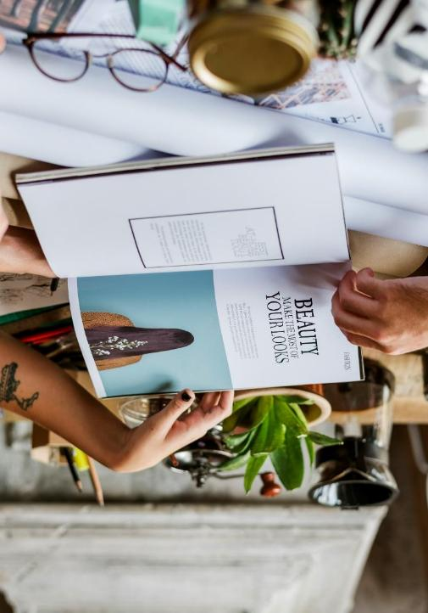
Magazine Deep Dive
Section 4

Slide 30
Magazine Engagement
Printed Magazines
Active Users
Last Month user
Read a printed magazine
Read magazine content online
Used a magazine app
Seen via aggregator (Apple News etc.)
Watched video from a magazine brand
Followed a magazine brand on social media
Subscribed to a printed magazine
Subscribed to digital magazine content
None of these
Q16. Which of the following have you done in the last month?
Base: Total Sample (578). Printed Magazines Users: Active (225); Last Month User (213). Magazine Websites or Apps Users: Active (253); Last Month User (168)
Txt; Txt = Significantly higher / lower @95% confidence level

Slide 31
Magazine Engagement
Magazine
Websites
or Apps
Active Users
Last Month user
Read a printed magazine
Read magazine content online
Used a magazine app
Seen via aggregator (Apple News etc.)
Watched video from a magazine brand
Followed a magazine brand on social media
Subscribed to a printed magazine
Subscribed to digital magazine content
None of these
Q16. Which of the following have you done in the last month?
Base: Total Sample (578). Printed Magazines Users: Active (225); Last Month User (213). Magazine Websites or Apps Users: Active (253); Last Month User (168)
Txt; Txt = Significantly higher / lower @95% confidence level

Slide 32
Magazine Thinking
Printed Magazines
Active Users
Last Month user
Printed magazines and digital magazine content serve different needs
Printed magazines are better for relaxing
Digital magazine content is better for quick access
Using magazines across formats makes them more valuable
Seeing magazines across platforms makes them more relevant
Printed magazines feel more premium than digital content
Q18. Please indicate how much you agree with the following statements about print and digital magazines
Printed Magazines:
Great for relaxing
More premium than digital content
Base: Total Sample (578). Printed Magazines Users: Active (225); Last Month User (213). Magazine Websites or Apps Users: Active (253); Last Month User (168)
Txt; Txt = Significantly higher / lower @95% confidence level

Slide 33
Magazine Thinking
Magazine
Websites
or Apps
Active Users
Last Month user
Printed magazines and digital magazine content serve different needs
Printed magazines are better for relaxing
Digital magazine content is better for quick access
Using magazines across formats makes them more valuable
Seeing magazines across platforms makes them more relevant
Printed magazines feel more premium than digital content
Q18. Please indicate how much you agree with the following statements about print and digital magazines
Magazine websites or apps:
Better for quick access
More value using magazines across formats
More relevance seeing magazines across platforms
Print still seen as more premium
Base: Total Sample (578). Printed Magazines Users: Active (225); Last Month User (213). Magazine Websites or Apps Users: Active (253); Last Month User (168)
Txt; Txt = Significantly higher / lower @95% confidence level

Slide 34
Magazine Action
Printed Magazines
Active Users
Last Month user
Q19. Which of the following have you done after reading or engaging with magazines and magazine content (print or digital)?
Talked to someone about something I read
Trusted a brand more after reading a story about it
Considered buying something I saw advertised
Searched for more information
Visited a website
Talked to someone about a brand/product
Bought something I saw advertised
Felt positive toward a brand I read a story about
Been to an event I saw featured or advertised
Shared content with someone else*
Talking about something read
Searching for more info
Visiting website
Purchase consideration
Brand positivity
Sharing content
* Shared content with someone else (e.g. gave them the magazine, posted the content on social media etc.)
Base: Total Sample (578). Printed Magazines Users: Active (225); Last Month User (213). Magazine Websites or Apps Users: Active (253); Last Month User (168)
Txt; Txt = Significantly higher / lower @95% confidence level

Slide 35
Magazine Action
Magazine
Websites
or Apps
Active Users
Last Month user
Q19. Which of the following have you done after reading or engaging with magazines and magazine content (print or digital)?
Talked to someone about something I read
Trusted a brand more after reading a story about it
Considered buying something I saw advertised
Searched for more information
Visited a website
Talked to someone about a brand/product
Bought something I saw advertised
Felt positive toward a brand I read a story about
Been to an event I saw featured or advertised
Shared content with someone else*
Visiting website
Talking about something read
Searching for more info
Purchase consideration
Brand positivity
* Shared content with someone else (e.g. gave them the magazine, posted the content on social media etc.)
Base: Total Sample (578). Printed Magazines Users: Active (225); Last Month User (213). Magazine Websites or Apps Users: Active (253); Last Month User (168)
Txt; Txt = Significantly higher / lower @95% confidence level

